Slide 1
Model-View-Controller Architecture
Hector Raphael Mojica

Slide 2
What is MVC?
Architectural design pattern which works to separate data and UI for a more cohesive and modularized system

Slide 3
What is MVC?
Model represents the data model
  “Manages behavior and data of the application domain”
View represents the screen(s) shown to the user
  “Manages the graphical and/or textual output to the portion of the bitmapped display that is allocated to its application”
Controller represents interactions from the user that changes the data and the view
  “Interprets the mouse and keyboard inputs from the user, commanding the model and/or the view to change as appropriate” (Burbeck)

Slide 4
How did it come about?
Presented by Trygve Reenskaug in 1979
First used in the Smalltalk-80 framework
  Used in making Apple interfaces (Lisa and Macintosh)

Slide 5
How does it work?
User inputs a command
Controller handles input and updates model or changes the view
View, which relies on model to show data to user, updates if necessary
Rinse and Repeat

Slide 6
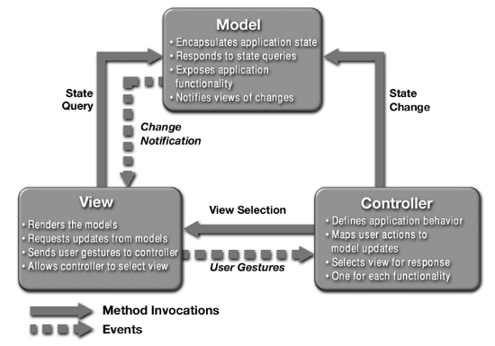
What is MVC?

Slide 7
What’s the point?
Provides a logical structure for heavily interactive system
Adheres to good engineering design principles and practices
  Information hiding, less coupling, simplicity, etc.
  Delegated control style

Slide 8
What’s the point?
Just plain easier (even if it doesn’t look it)!
  Study shows that most introductory CS college students tend to clump a UI program into one big monolithic main class
  Unfamiliarity stems from student tendency to program according to styles presented in textbooks and not being introduced to design principles early (Morse)

Slide 9
Conclusion
MVC is a sound architectural design for almost any GUI application

Slide 10
References
Wikipedia
Fox, Christopher. Introduction to Software Engineering Design. Boston: Pearson, 2006.
Burbeck, Steve. Applications Programming in Smalltalk-80(TM): How to use Model-View-Controller (MVC). http://st-www.cs.uiuc.edu/users/smarch/st-docs/mvc.html
Morse, Scot F. Introducing Application Design and Software Engineering Principles in Introductory CS Courses: Model-View-Controller Java Application Framework.

